Slide 1
3-D Technology

Slide 2
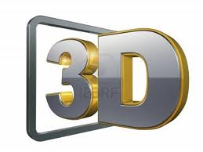
Group Members
DINEESHYA WIJEWARDANA
SHASHIPRABHA RATHNAYAKE
UPULI ISHARA MENIKE

Slide 3
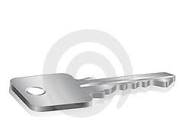
What are we going to talk about?
Introduction
Users of 3-D technology
Films
Television
Cameras
Computer Graphics
In future

Slide 4
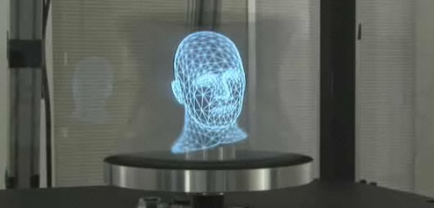
Introduction
3D (Three-dimension) refers to how your eyes and brain create the impression of a third dimension.
It offers a new experience that differs fundamentally from all other audiovisual media.

Slide 5
Users of 3-D Technology
Computer gamers
Architects
Landscape artists
Industrial designers
Engineers
Meteorologists
Scientists
Doctors ; Computer Axial Tomography (CAT)

Slide 6
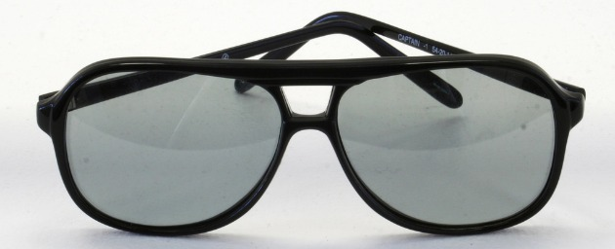
What we watch

Slide 7
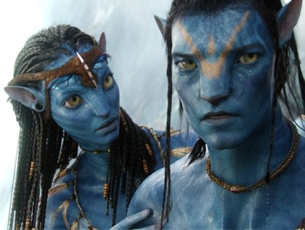
Films
Film has been one of the pioneers of 3D.
There are largely two ways 3D has been achieved in motion pictures;
Anaglyph.
Polarization.

Slide 8
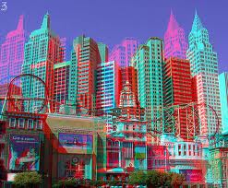
Anaglyph
The earliest method of presenting theatrical 3-D.
A fancy way of referring to the red-and-blue glasses we used to wear.
Other colors could be used, providing they were distinct enough to be separated on screen.

Slide 9
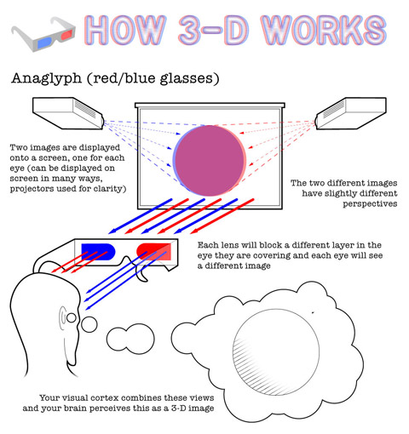

Slide 10
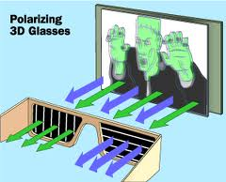
Polarization
More modern choice for cheap 3D.
They work kind of the same way as the red/blue glasses though, but at different polarizations.
The corresponding glasses would allow horizontal polarization in one eye and vertical polarization in the other.

Slide 11
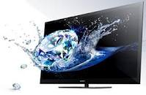
Television
Use the same techniques in film projectors for home theatres.
Films use special silver-coated screens but this is not used in television.
Two ways to get 3D at homes .
They are active 3D and passive 3D.

Slide 12
Active 3D
Involves wearing those electronic Robocop glasses.
It actively open and close the shutters.
These shutter lenses are made possible because of the refresh rate on televisions.
3D-enabled televisions to have high image refresh rates.

Slide 13
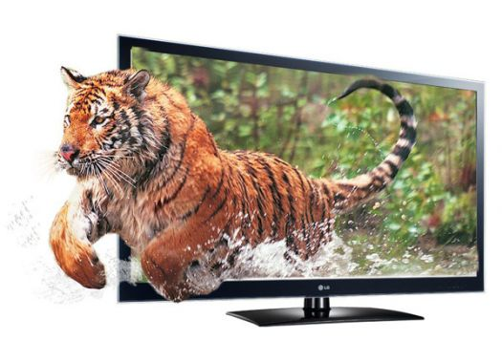
Passive 3D
Less common but run much like 3D film.
Thin, lenticular screen over the standard display.
Not required of bulky expensive glasses.
Each eyes sees one half of the screen at a given time.

Slide 14
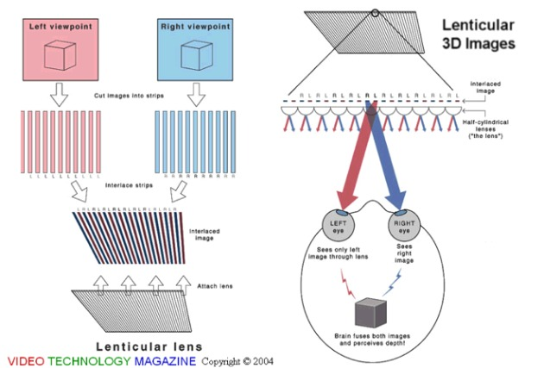

Slide 15
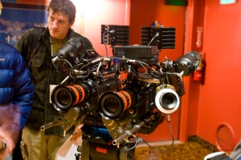
How it’s made

Slide 16
Cameras
3D image, need two versions of the same scene filmed from the precisely correct angle.
Filmmakers triangulate the distance between the two cameras and focus on the same object.
Close-ups, a staple of modern film, are hard to capture in 3D.
To solve this filmmakers use mirror rigs.

Slide 17
Computer Graphics
The representation and manipulation of image data by a computer with help from specialized software and hardware.
Animators create two versions of each frame, one from the perspective of each eye.
3D video games can be created by using the same technique.

Slide 18
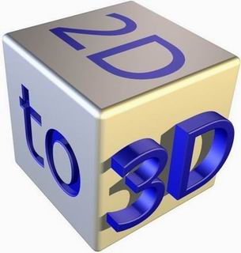
Sub Topics in Computer Graphics
There are 3 basic operations involved in creating a computer graphics of an object:
Modeling the shapes
Rendering
Animation

Slide 19
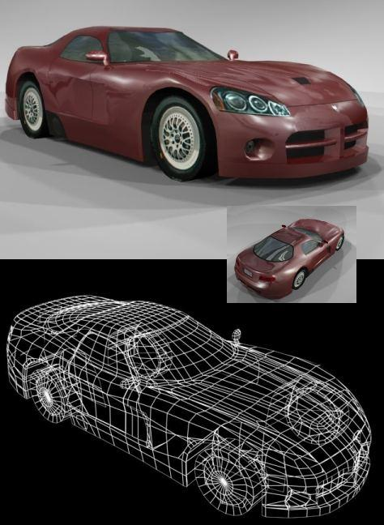
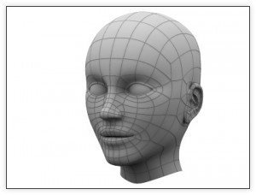
3D Modeling
3D modeling refers to the creation of the 3D model itself.
A 3D model is a mathematical representation of an object.

Slide 20
Rendering
In 3D graphics rendering means the calculation of the final image from the scene that includes
models
textures
lights
special effects
and cameras

Slide 21
Animation
3D graphics software is often called animation software.
four separate steps OF Creating 3D character animation.
Modeling the character
Rigging the character
Skinning the character
Animating the character

Slide 22
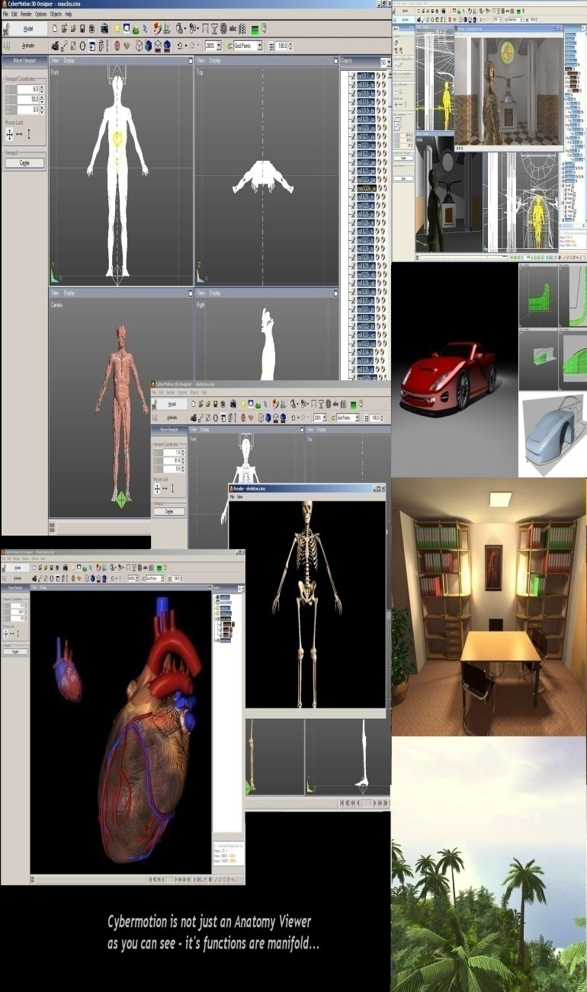
3D Software
3DS MAX, MAYA, MUD BOX (AUTODESK)
HOUDINI (SIDE EFFECTS SOFTWARE)
LIGHT WAVE 3D (NEWTEK)
SOFTIMAGE|XSI (AVID)
VUE 6 (E-ON SOFTWARE)
ZBRUSH (PIXOLOGIC)
CINEMA 4D (MAXON)
BLENDER (BLENDER FOUNDATION)

Slide 23
Applications of Computer Graphics
Making movies
Desktop publishing
Cartography
Multimedia
Large industrial process monitoring
Satellite imaging
Technical drawing

Slide 24
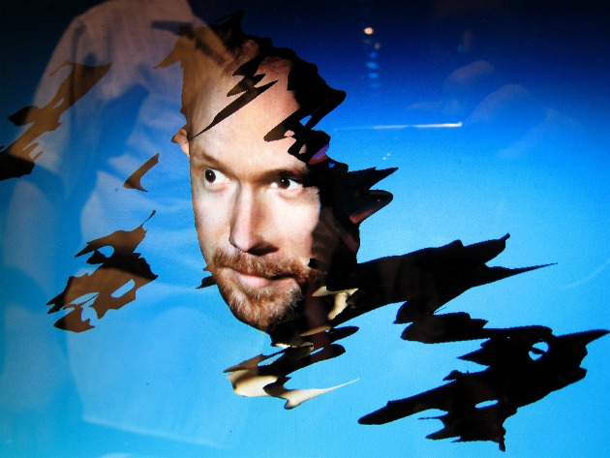
In Future
Necessity to solve the problem of fundamental halving of images.
Ability to achieve the illusion of 3D with modern technology.
3D possibility in a number of handheld and consumer products.

Slide 25
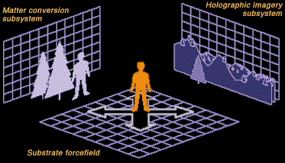
Rise of the technology that uses auto stereoscopy, or 3D that doesn’t require glasses in any way in the coming years.
Ability to walk around the video being displayed and see it in true 3-dimensional fashion. (A holodeck)

